Slide 1
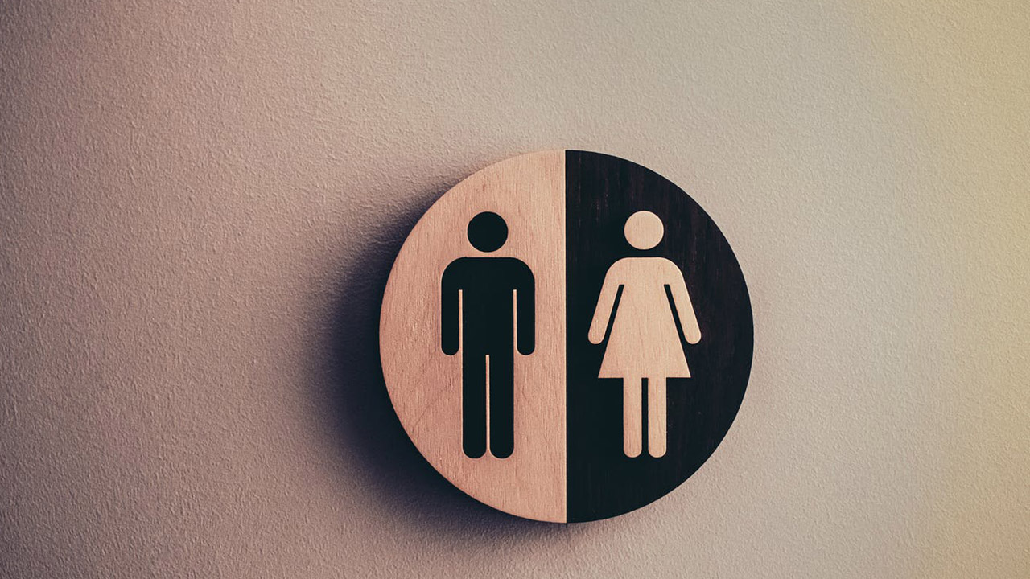
Gender Policy

Slide 2
Definition
A gender policy is a set of rules, tactics, and measures intended to combat gender inequality and advance gender equality in a particular setting, like a government, institution or organization.
The goal of gender policy is to eradicate discrimination based on gender and establish a society in which men and women have equal rights and opportunities

Slide 3
Practice of this policy in the government sector of Bangladesh
The first principles of this policy emphasized equity and equality. But there occurs gender inequality slightly. In our country, women are generally being paid less opportunities than men. Our government encourages the active participation of women in decision-making processes and leadership roles equally but there are some limitations for them

Slide 4
Recommendation
Here I draw some recommendations for implementing gender policy in Bangladesh. Implementing gender policy is essential to the accomplishment of everyone's human rights and is inextricably related to sustainable development.

Slide 5
Recommendation Here I draw some recommendations for implementing gender policy in Bangladesh. Implementing gender policy is essential to the accomplishment of everyone's human rights and is inextricably related to sustainable development
Government and Public Sector | Ministry of Women and Children Affairs (MOWCA), Ministry of Labour and Employment, Ministry of Education, Ministry of Health, and Ministry of Finance
Civil Society Organizations and (NGOs) | BRAC, Nari Unnayan Shakti, Ain o Salish Kendra (ASK), UNDP, UN Women, World Bank & UNICEF

